Slide 1

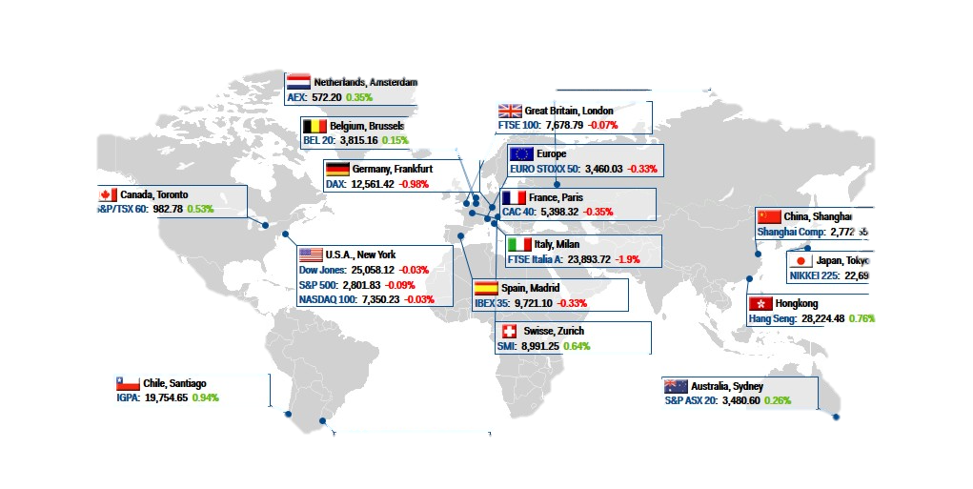
U.S. News VS. GLOBAL STOCK MARKETS
BY: JUSTIN JOHN, CHRISTOPHER LARSON, FARAH AWAD, STEPHEN BERNARD

Slide 2
Core Question
How do global stock markets fluctuate based on United States’ news source (New York Times) headlines sentiment analysis of market indices?
Markets to predict daily percent change - SP500(USA), FTSE 100(UK), FCHI CAC 40(FR), GDAXI(GER), Tokyo Exchange(Japan)
How are major global markets going to perform in the next 7 days with upcoming us presidential elections?

Slide 3
Machine Learning Models & NLP Kits
Linear Regression Model:
n/a
Logistical Regression Model
n/a
IBM Watson NLP
n/a

Slide 4
Data Sources & Model Training
Data Sources:
New York Times news API (3-months)
Stock market data (3-months)
Describe the exploration and cleanup process.
Discuss any problems that arose with preparing the data or training the model that you didn't anticipate.
Discuss the overall training process and highlight anything of interest with the training process: Cloud resources used, training time required, issues with training.

Slide 5
Model Evaluation
Discuss the techniques you used to evaluate the model performance.

Slide 6
Results
Discuss your findings. Was the model sufficient for the predictive task? If not, why not?
What inferences or general conclusions can you draw from your model performance?

Slide 7
Postmortem
Discuss any difficulties that arose, and how you dealt with them.
Discuss any additional questions or problems that came up but you didn't have time to answer:
What would you research next if you had two more weeks?

Slide 8

Any Questions?

